Slide 1
Autodesk Vault Workgroup | Professional | Office
Vault Data Standard – Configuration Editor
Markus Koechl
Solutions Engineer PDM|PLM – Autodesk Central Europe

Slide 2
Agenda
Overview
Scope and Benefits
Download & Subscribe
Get Started
Visual Studio | PowerShell Extension
Setup Visual Studio
Use Case Examples
Best Practice – Change Default Script to Custom Script
Add Configurations
Adding Folders
Adding Branches
Evaluate Vault API

Slide 3
Overview
Scope | Benefits | Availability

Slide 4
VDS-Configuration-Editor | Scope & Benefits
Edit any VDS Configuration Files/File Types
Manage Configuration File Links/Configuration
Evaluate Vault API Commands
Watch Variables
Review Default Configuration
Review Quickstart Configuration
Edit & Compare Configurations
Reuse Code from Sample Scripts
Reuse Snippets from Libraries
Add Custom[er] Configurations
Install VDS-Editor-Project template

Slide 5
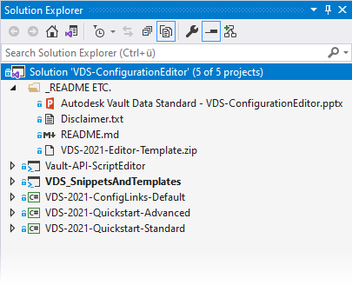
VDS-ConfigurationEditor | Supported Vault/VDS Versions
Vault-API-Script-Samples
Vault 2021 SDK
VDS Snippets and Templates
Vault 2018 and newer
Edit default configuration files
Vault Data Standard 2021
Edit linked Quickstart-Sample configuration files
VDS-Quickstart-Sample-2021

Slide 6
VDS-Configuration-Editor | Download & Subscribe
GitHub Repository
Adds any valuable updates / enhancements to current branch
Link - https://github.com/koechlm/VDS-Configuration-Editor
Follow Me – stay informed about new commits
New Snippets
Vault-API-Script Samples

Slide 7
Get Started
Setup Visual Studio Environment

Slide 8
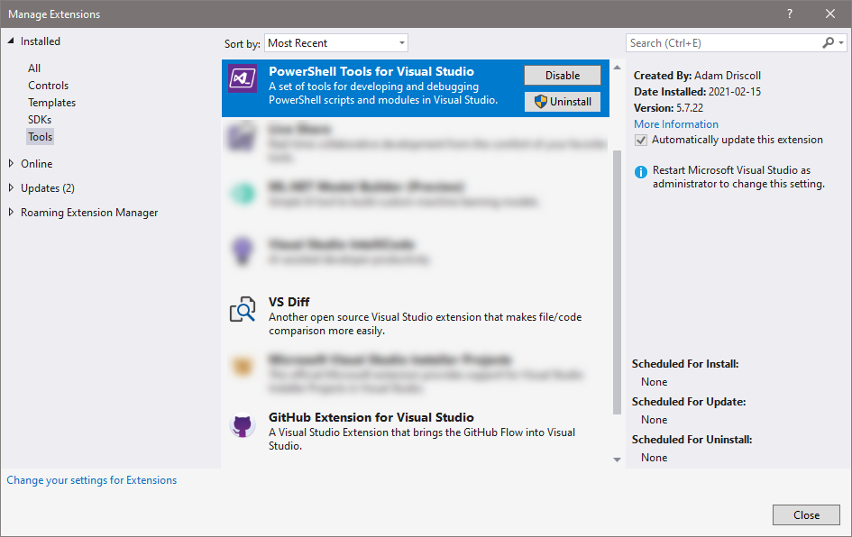
Install | Visual Studio 2017 or 2019 Editions
Install Visual Studio 2017 or 2019
Add – PowerShell Extension
Download from Visual Studio Marketplace
[Optional] Add VS Diff or File Differ
[Optional] Add Source Control
Note – VDS-Configuration-Editor manages links and not the native configuration files!

Slide 9
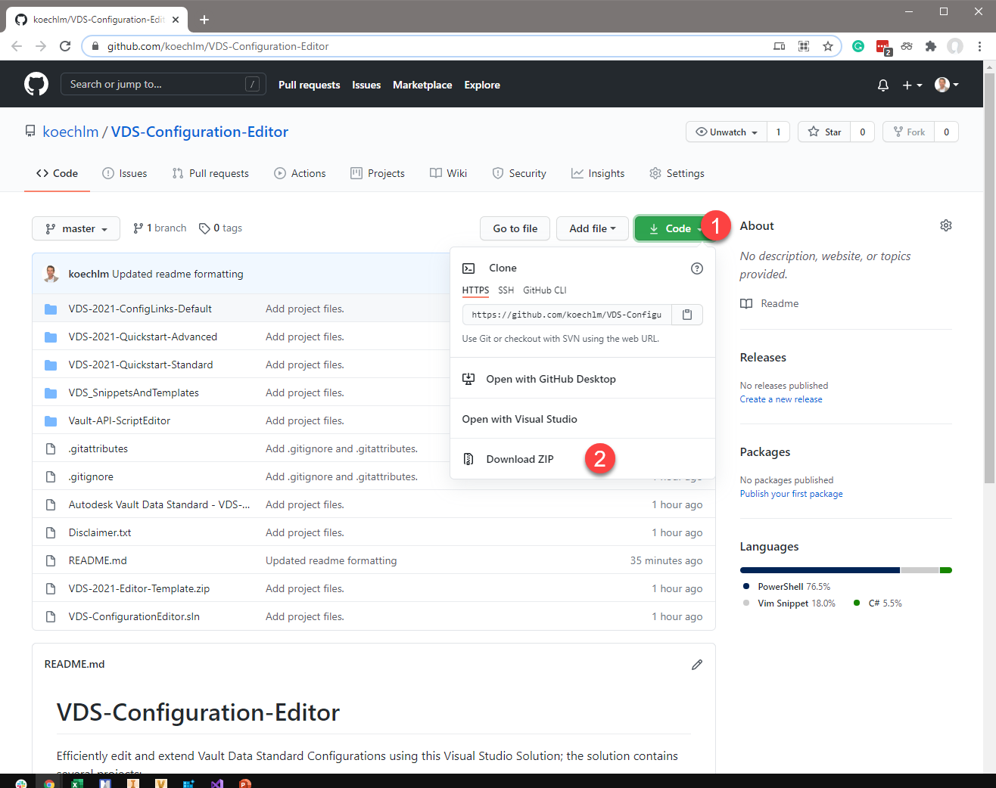
Download VDS-Configuration-Editor Solution
https://github.com/koechlm/VDS-Configuration-Editor
Download ZIP
Extract to any location
C:\...\ Drive based is recommended

Slide 10
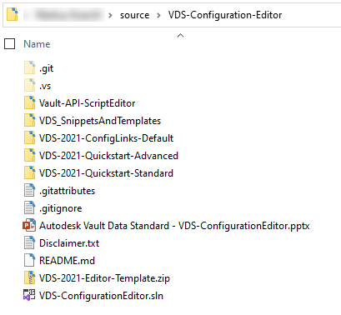
Extract VDS-Configuration-Editor Solution
Extract to any location
C:\...\ Drive based is recommended as the project use relative paths to C:\Program Files\Autodesk\...

Slide 11
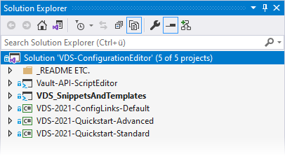
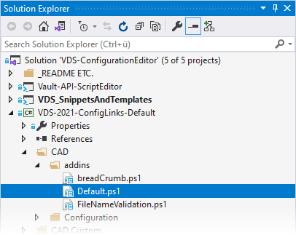
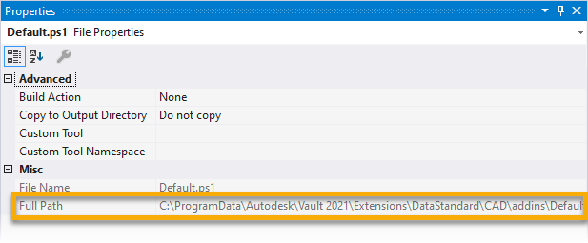
Open VDS-Configuration-Editor Solution
Open the solution
VDS-ConfigurationEditor.sln
Expand VDS-202x-ConfigLinks-Default and check for valid links
Note – Data Standard 202x has to be installed as a pre-requisite

Slide 12
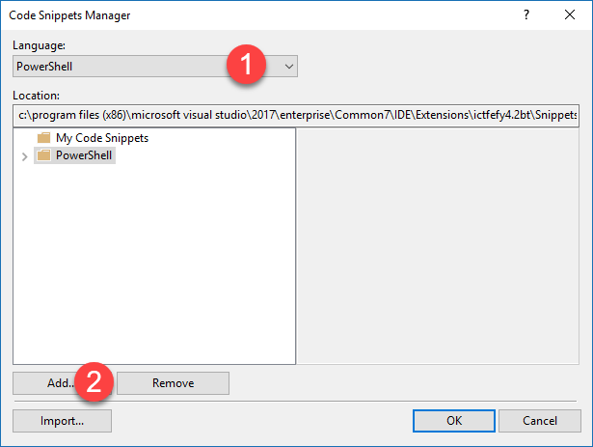
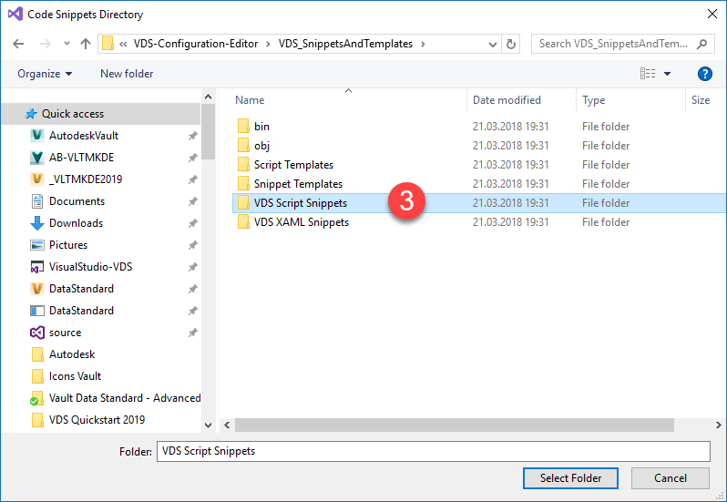
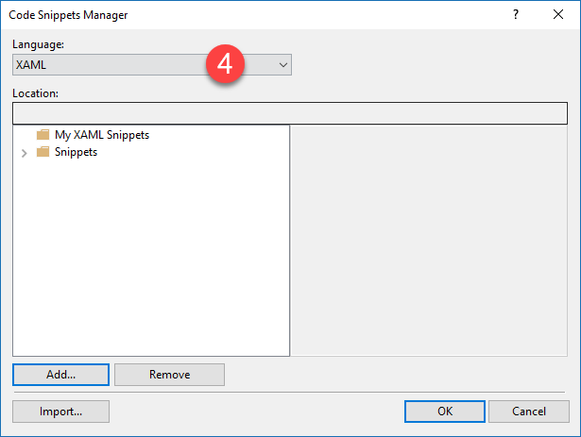
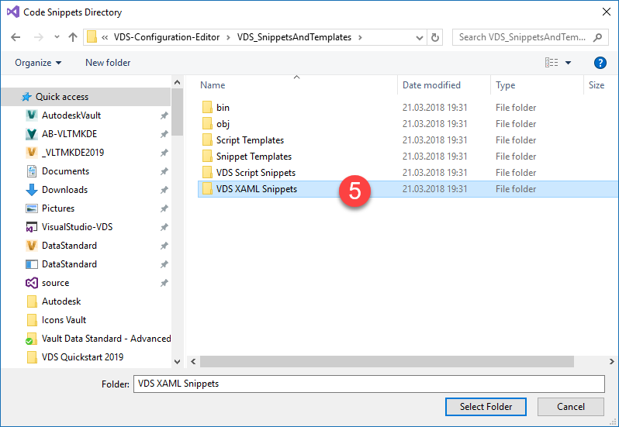
Setup | Code Snippet Manager
Add Powershell and XAML Snippets
Tools -> Code Snippets Manager
Select PowerShell / Add…
Select XAML / Add…

Slide 13
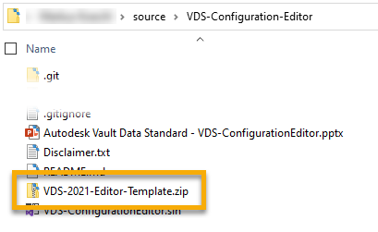
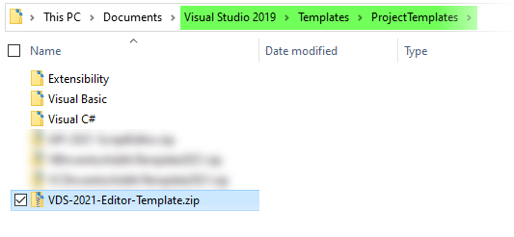
Setup | VDS Editor Templates
[Optionally] Add Project Template 2021 or later
Allows to create new Editor Projects for the chosen Vault Version and Version SDK
Copy VDS-202x-Editor-Template.zip to your Visual Studio’s ProjectTemplates folder

Slide 14
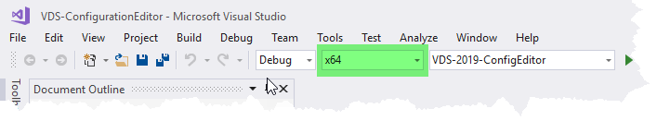
Setup | VDS Editor Template 2019 and later
Note – Starting with 2019 VDS dlls are compiled for x64 CPU instead of AnyCPU. As a result, the editor configuration requires switching to x64.

Slide 15
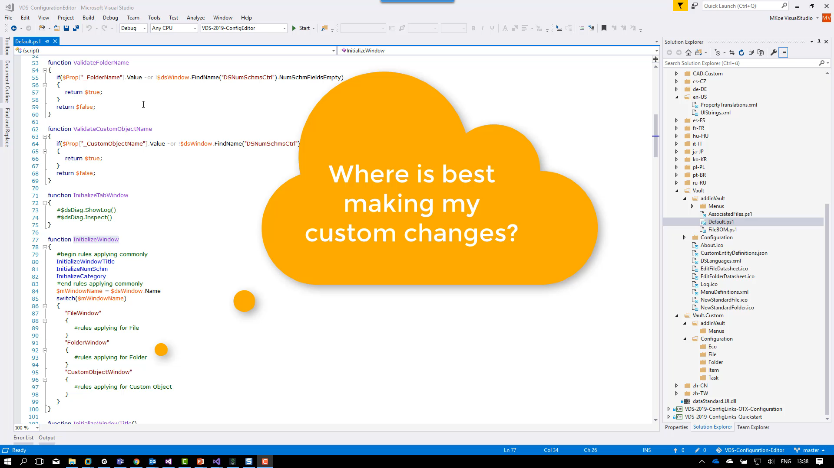
Edit Configuration | Example
How to edit a VDS 201x RTM Configuration?

Slide 16
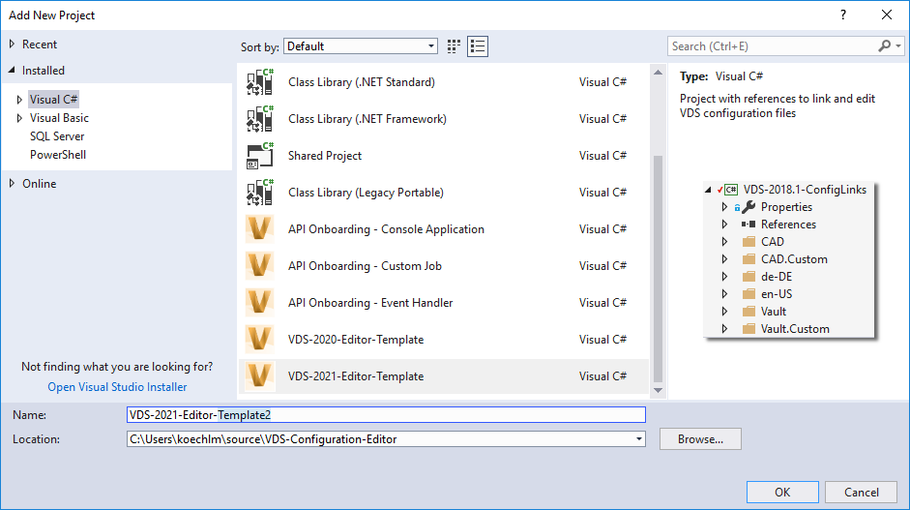
Create New Configuration File Set
How to edit a custom configuration file set?
You don’t know the configured files / file names?
Solution
Add New Project -> Select Template
Drag & Drop Configuration File Set
NOTE – Press ALT key while dragging!

Slide 17
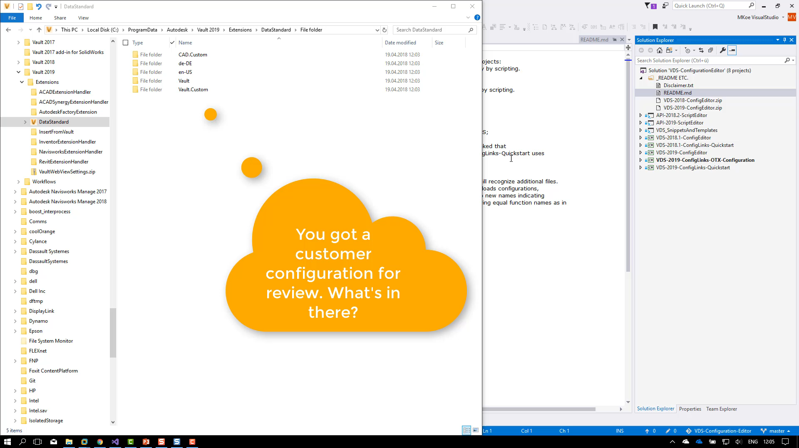
Create New Configuration File Set
How to edit a custom configuration file set?
You don’t know the configured files / file names?

Slide 18
Best Practice

Slide 19
Change Default Script to Custom Script
How to compare with default later on?
Example – Customize the CustomObject Dialog
Legacy Solution Approach
Edit existing file .\Vault\Configuration\CustomObject.xaml
Solution Approach #1
Copy original file to .\Vault.Custom\Configuration\CustomObject.xaml
Edit this file…

Slide 20
Change Default Script to Custom Script
Compare VDS Quickstart 2019 Configuration
Example – Customize the CustomObject Dialog
Solution Approach #2
Copy original file to .Vault.Custom\Configuration\MyCustomObject.xaml
VDS will continue to load the default one…
Customize Create*.ps1 and Edit*.ps1 to enable the new one!
Copy *ps1 files to .\Vault.Custom\addins\Menus\
Assign $dialog.XamlFile to the new path & file name
Adopt *.ps1 names in MenuDefinition.xml if renamed

Slide 21
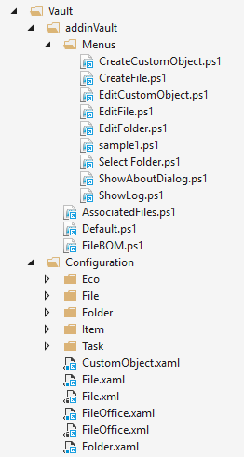
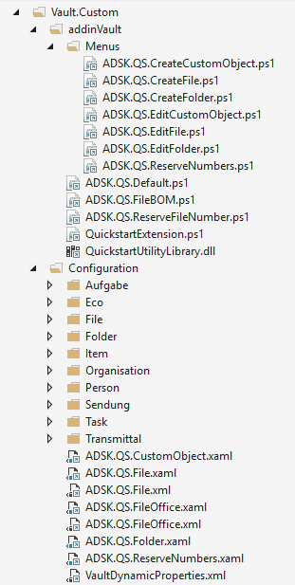
Quickstart 2019 | Compare Changes – Approach #2

Slide 22
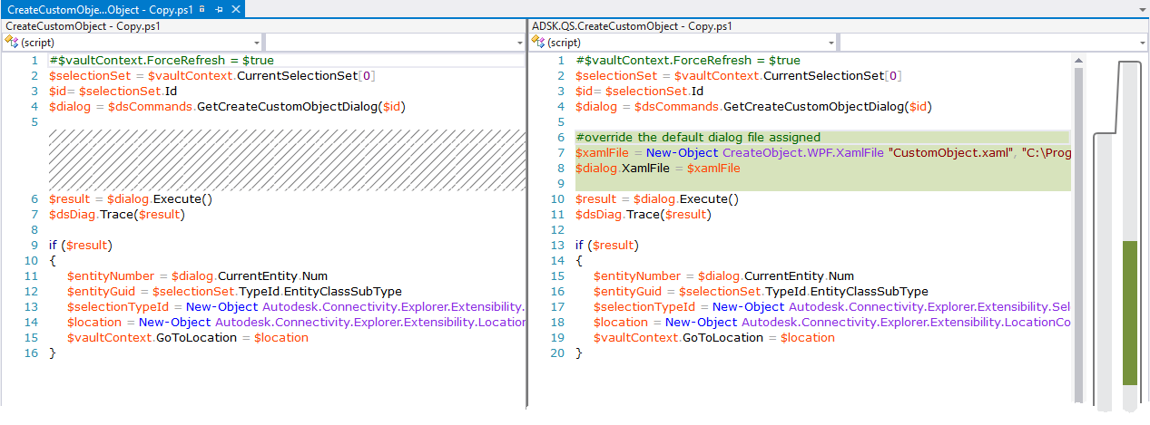
Quickstart 2019 | Compare Changes *Create*/*Edit*.ps1

Slide 23
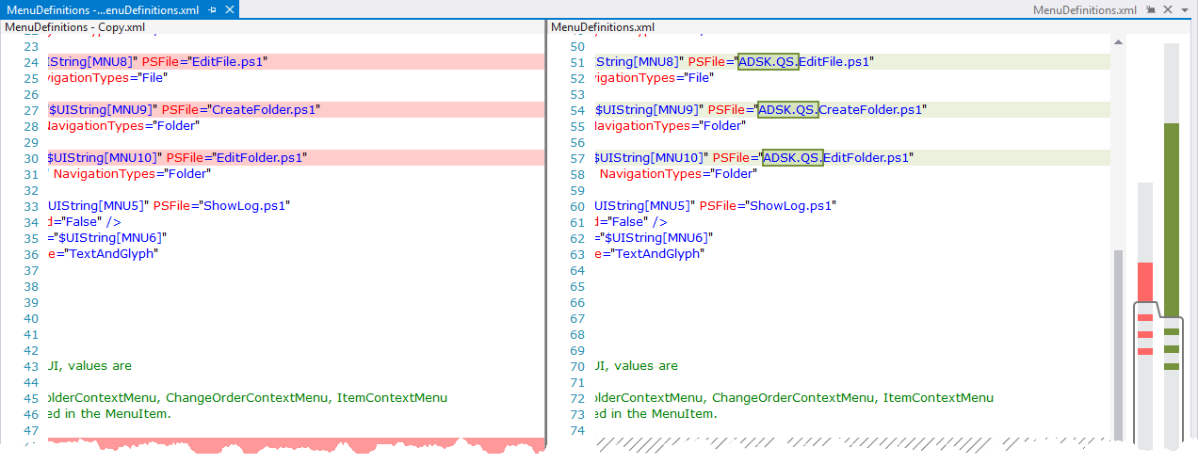
Quickstart 2019 | Compare Changes Menudefinition.xml

Slide 24
Best Practice Adding Customizations | Summary
Minimum Action – Separate Custom Configuration
Copy Default Script/Dialog File to .\*.Custom\* Locations
Optimum Actions – Encapsulate Custom Configuration
Copy & Rename Script/Dialog File to .\Custom\* Locations
Update all Relationships
Benefit – Unique names indicate individual functionality
Benefit – No risk to exchange configuration files just by name
Benefit – Easily edit & compare default & customized version

Slide 25
Evaluate Vault API

Slide 26
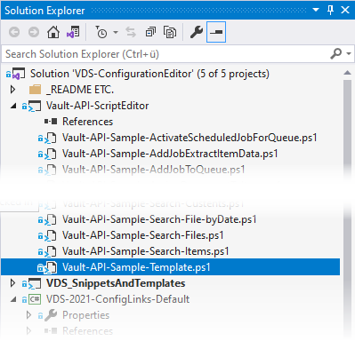
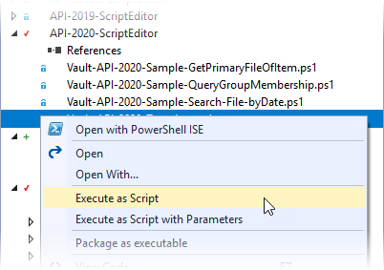
Evaluate Vault API | PowerShell Script – Vault API
API-2020-ScriptEditor
Copy & Paste Template
Vault-API-Sample-Template.ps1
Open your copy
Edit Server / User Data
Copy AdskLicensingSDK_x.dll (see note in template) to the PowerShell execution folder
Select License Agent
Server: Script runs on machine without Vault
Client: Vault Client Installation required
None: Read-only Access
Add your code….
Select script and execute

Slide 27
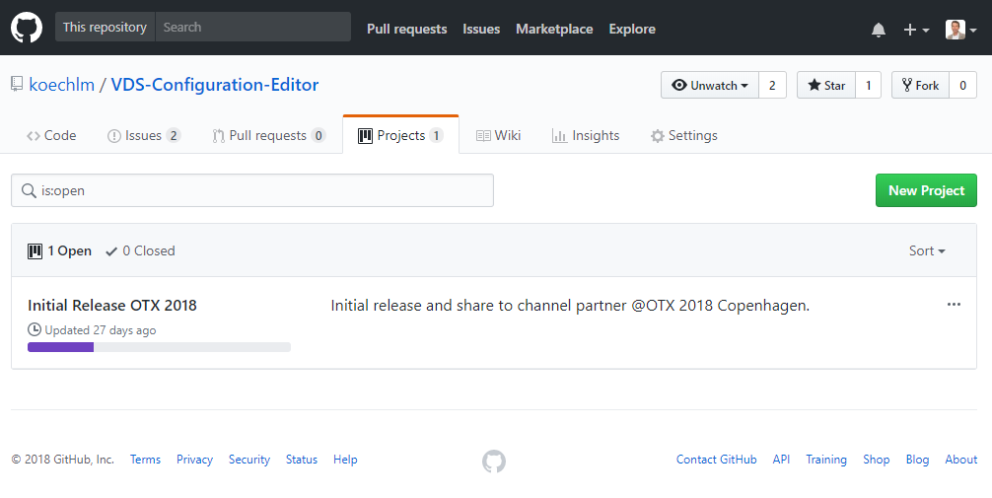
VDS Configuration Editor | Summary
Single source for templates, snippets and function samples
Always up to date – as it is Markus’ active editing environment
Follow on GitHub to stay tuned
Download partially the resources only
https://github.com/koechlm/VDS-Configuration-Editor

